Slide 1

2018 Seminar on Predictive Modeling: Ensemble Models using R
Jeffrey Strickland, Ph.D., CMSP, ASEP
CEO Humalytica Analytics

Slide 2
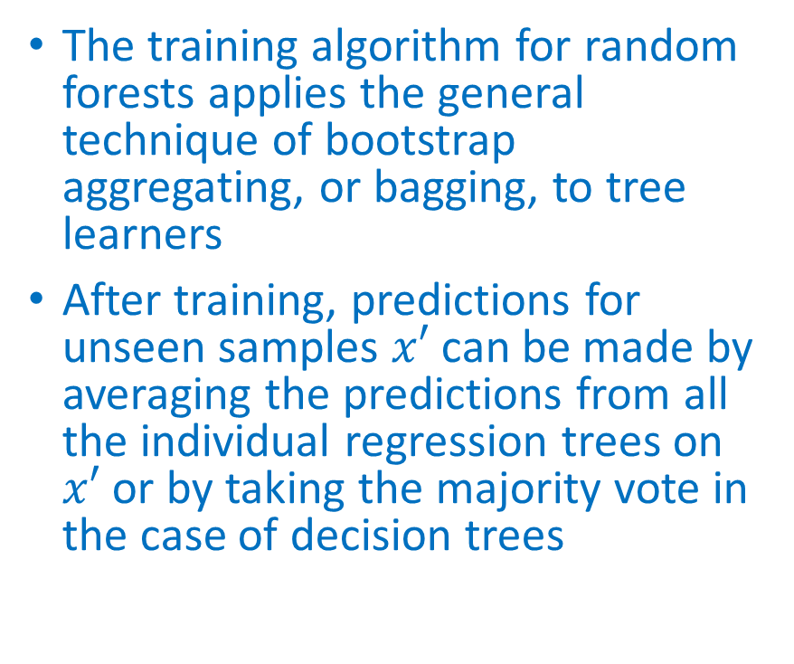
Random Forest
Random forests are an ensemble learning method for classification (and regression) that operate by constructing a multitude of decision trees at training time and outputting the class that is the mode of the classes output by individual trees
The algorithm for inducing a random forest was developed by Leo Breiman (Breiman L. , Random Forests, 2001) and Adele Cutler (Liaw, 2012), and “Random Forests” is their trademark
The training algorithm for random forests applies the general technique of bootstrap aggregating, or bagging, to tree learners
After training, predictions for unseen samples $x′$ can be made by averaging the predictions from all the individual regression trees on $x′$ or by taking the majority vote in the case of decision trees

Slide 3
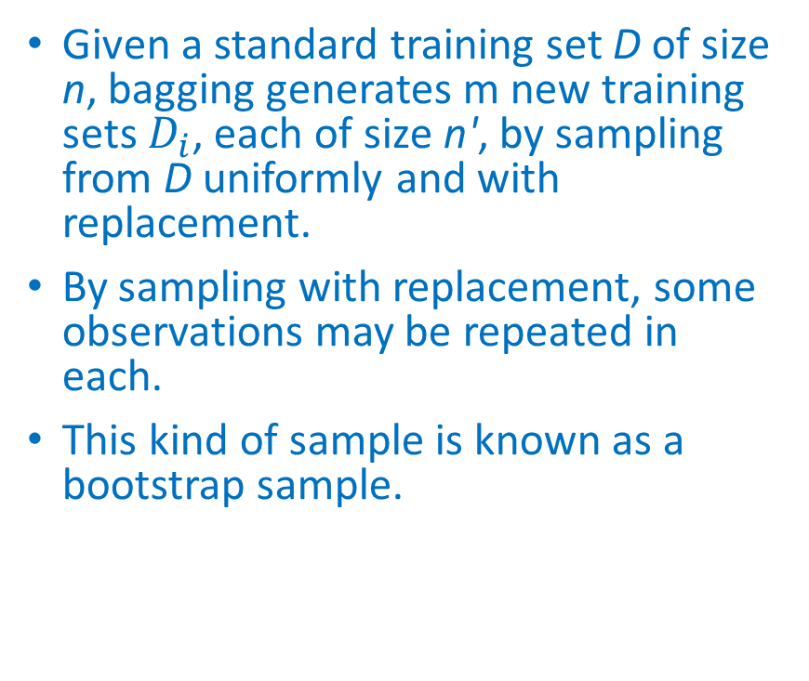
Bootstrapping and Bagging
Bootstrap aggregating, also called bagging, is a machine learning ensemble meta-algorithm designed to improve the stability and accuracy of machine learning algorithms used in statistical classification and regression.
It also reduces variance and helps to avoid overfitting.
Although it is usually applied to decision tree methods, it can be used with any type of method.
Bagging is a special case of the model averaging approach.
Given a standard training set D of size n, bagging generates m new training sets $D_{i}$, each of size n', by sampling from D uniformly and with replacement.
By sampling with replacement, some observations may be repeated in each.
This kind of sample is known as a bootstrap sample.

Slide 4
Random Forest using R
randomForest implements Breiman’s random forest algorithm (based on Breiman and Cutler’s original Fortran code) for classification and regression in R.
It can also be used in unsupervised mode for assessing proximities among data points.
We use the Forensic Glass data set was used in Chapter 12 of MASS4 (Venables and Ripley, 2002) to show how random forests work

Slide 5
Random Forest for Forensic Glass using R
library(randomForest)
library(MASS)
data(fgl)
set.seed(17)
fgl.rf <- randomForest(type ~ ., data = fgl, mtry = 2, importance = TRUE, do.trace = 100)
ntree OOB 1 2 3 4 5 6
100: 23.83% 14.29% 26.32% 70.59% 23.08% 22.22% 13.79%
200: 20.09% 10.00% 19.74% 70.59% 23.08% 22.22% 13.79%
300: 20.56% 10.00% 23.68% 64.71% 23.08% 22.22% 10.34%
400: 18.69% 10.00% 18.42% 58.82% 23.08% 22.22% 13.79%
500: 19.16% 10.00% 19.74% 58.82% 23.08% 22.22% 13.79%

Slide 6
Random Forest for Forensic Glass using R
Call:
randomForest(formula = type ~ ., data = fgl, mtry = 2, importance = TRUE, do.trace = 100)
Type of random forest: classification
Number of trees: 500
No. of variables tried at each split: 2
OOB estimate of error rate: 19.16%
Confusion matrix:
WinF WinNF Veh Con Tabl Head class.error
WinF 63 6 1 0 0 0 0.1000000
WinNF 10 61 1 2 1 1 0.1973684
Veh 8 2 7 0 0 0 0.5882353
Con 0 2 0 10 0 1 0.2307692
Tabl 0 2 0 0 7 0 0.2222222
Head 1 3 0 0 0 25 0.1379310
print(fgl.rf)

Slide 7
Random Forest and SVM Compared
library(ipred)
set.seed(131)
error.RF <- numeric(10)
for(i in 1:10) error.RF[i] <- errorest(type ~ ., data = fgl, model = randomForest, mtry = 2)$error
summary(error.RF)
library(e1071)
set.seed(563)
error.SVM <- numeric(10)
for (i in 1:10) error.SVM[i] <- errorest(type ~ ., data = fgl, model = svm, cost = 10, gamma = 1.5)$error
summary(error.SVM)
Min. 1st Qu. Median Mean 3rd Qu. Max.
0.1822 0.1939 0.2079 0.2065 0.2150 0.2383
Min. 1st Qu. Median Mean 3rd Qu. Max.
0.3645 0.3785 0.3808 0.3794 0.3832 0.3879
COMPARE

Slide 8
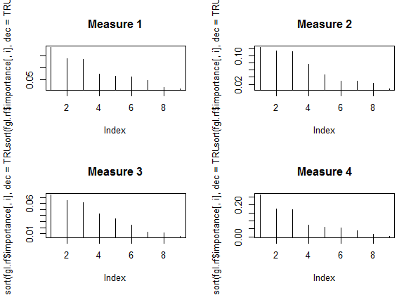
Variable Importance of the Forensic Glass Data Set
par(mfrow = c(2, 2))
for (i in 1:4) plot(sort(fgl.rf$importance[,i], dec = TRUE), type = "h", main = paste("Measure", i))

Slide 9
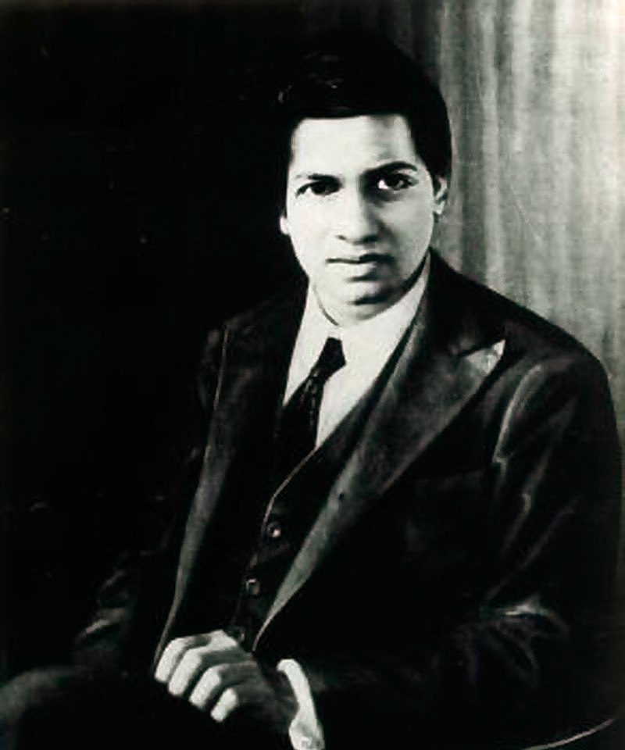
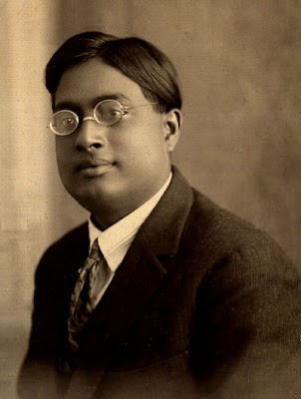

Who’s who in India?
Who was the man who knew infinity - independently compiled nearly 3,900 results and died at age 32
Srinivasa Ramanujan
Satyendra Nath Bose
Mahatma Gandhi

Slide 10

The Man Who Knew Infinity (2016)

Slide 11
caretEnsemble
caretList is a flexible function for fitting many different caret (Classification And REgression Training) models, with the same resampling parameters, to the same dataset
Returns a convenient list of caret objects which can later be passed to caretEnsemble and caretStack.
caretList has almost exactly the same arguments as train (from the caret package), with the exception that the trControl argument comes last.
Can handle both the formula interface and the explicit x, y interface to train.
The formula interface introduces some overhead and the x, y interface is preferred.
caretEnsemble has 2 arguments that can be used to specify which models to fit:
methodList and tuneList.
methodList is a simple character vector of methods that will be fit with the default train parameters
tuneList can be used to customize the call to each component model and will be discussed in more detail later.
First, lets build an example dataset (adapted from the caret vignette):

Slide 12
Example Dataset
library("caret")
library("mlbench")
library("pROC")
data(Sonar)
set.seed(107)
inTrain <- createDataPartition(y =
Sonar$Class, p = .75,
list = FALSE)
training <- Sonar[ inTrain,]
testing <- Sonar[-inTrain,]
my_control <- trainControl(
method="boot",
number=25,
savePredictions="final",
classProbs=TRUE,
index=createResample(training$Class, 25),
summaryFunction=twoClassSummary
)

Slide 13
The Prediction Function
We can use the predict function to extract predictions from this object for new data:
p <- as.data.frame(predict(
model_list,
newdata=head(testing)))
print(p)
glm rpart
1 2.220446e-16 0.77941176
2 2.220446e-16 0.08823529
3 2.220446e-16 0.08823529
4 6.751095e-05 0.08823529
5 2.220446e-16 0.66666667
6 7.654240e-01 0.77941176

Slide 14
Additional Control
If you desire more control over the model fit, use the caretModelSpec to construct a list of model specifications for the tuneList argument.
This argumenent can be used to fit several different variants of the same model, and can also be used to pass arguments through train down to the component functions (e.g. trace=FALSE for nnet):
library("mlbench")
library("randomForest")
library("nnet")
model_list_big <- caretList(
Class~., data=training,
trControl=my_control,
metric="ROC",
methodList=c("glm", "rpart"),
tuneList=list(
rf1=caretModelSpec(method="rf", tuneGrid=data.frame(.mtry=2)),
rf2=caretModelSpec(method="rf", tuneGrid=data.frame(.mtry=10), preProcess="pca"),
nn=caretModelSpec(method="nnet", tuneLength=2, trace=FALSE)
)
)

Slide 15
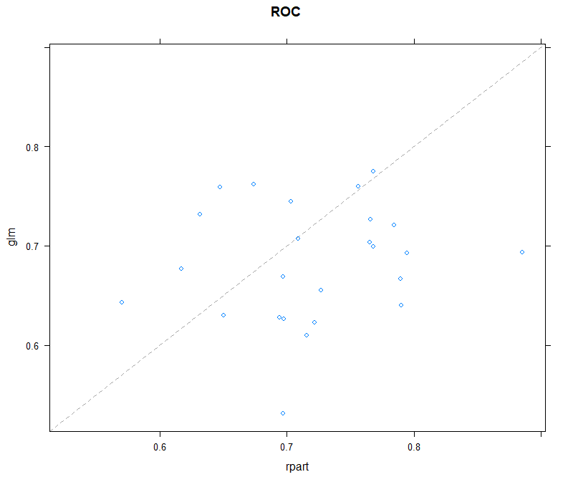
xyplot
caretList is the preferred way to construct list of caret models in this package, as it will ensure the resampling indexes are identical across all models.
Lets take a closer look at our list of models:
> xyplot(resamples(model_list))
As you can see from this plot, these 2 models are un-correlated, and the rpart model is occasionally anti-predictive, with a few re-samples showing AUCS around 0.3 to 0.4.

Slide 16
Correlation
We can confirm the 2 model“s correlation with the modelCor function from caret (caret has a lot of convienent functions for analyzing lists of models):
> modelCor(resamples(model_list))
These 2 models make a good candidate for an ensemble: their predicitons are fairly un-correlated, but their overall accuaracy is similar.
glm rpart
glm 1.0000000 0.1426353
rpart 0.1426353 1.0000000

Slide 17
Linear Greedy Optimization on AUC
We do a simple, linear greedy optimization on AUC using caretEnsemble:
> greedy_ensemble <- caretEnsemble(
model_list,
metric="ROC",
trControl=trainControl(
number=2,
summaryFunction=twoClassSummary,
classProbs=TRUE
))
> summary(greedy_ensemble)
The ensemble’s AUC on the training set resamples is 0.76, which is about 7% better than the best individual model.
The following models were ensembled: glm, rpart
They were weighted:
1.4489 -0.9559 -2.0442
The resulting ROC is: 0.7724
The fit for each individual model on the ROC is:
method ROC ROCSD
glm 0.6829333 0.05890797
rpart 0.7206765 0.06849524

Slide 18
Confirm Results with Test Set
We can confirm this finding on the test set:
> library("caTools")
> model_preds <- lapply(model_list, predict,
newdata=testing, type="prob")
> model_preds <- lapply(model_preds,
function(x) x[,"M"])
> model_preds <- data.frame(model_preds)
> ens_preds <- predict(greedy_ensemble,
newdata=testing, type="prob")
> model_preds$ensemble <- ens_preds
> caTools::colAUC(model_preds, testing$Class)
The ensemble“s AUC on the test set is about 6% higher than the best individual model.
glm rpart ensemble
M vs. R 0.6496914 0.6566358 0.6967593

Slide 19
Variable Importance
We can also use varImp to extract the variable importances from each member of the ensemble, as well as the final ensemble model:
> varImp(greedy_ensemble)
overall glm rpart
V60 0.00000000 0.00000000 0.000000
V5 0.01950468 0.06121576 0.000000
V53 0.03043307 0.09551468 0.000000
V43 0.04623751 0.14511716 0.000000
V45 0.09440993 0.29630709 0.000000
V57 0.10061978 0.31579679 0.000000
V55 0.12859074 0.40358409 0.000000
V46 0.13994271 0.43921244 0.000000
V26 0.14222333 0.44637019 0.000000
V28 0.14709630 0.46166408 0.000000
V39 0.21379329 0.67099367 0.000000
.
.
.

Slide 20
caretStack
caretStack allows us to move beyond simple blends of models to using “meta-models” to ensemble collections of predictive models.
DO NOT use the trainControl object you used to fit the training models to fit the ensemble. The re-sampling indexes will be wrong.
Fortunately, you don“t need to be fastidious with re-sampling indexes for caretStack, as it only fits one model, and the defaults train uses will usually work fine:
glm_ensemble <- caretStack(
model_list,
method="glm",
metric="ROC",
trControl=trainControl(
method="boot",
number=10,
savePredictions="final",
classProbs=TRUE,
summaryFunction=twoClassSummary
)
)

Slide 21
Results
> model_preds2 <- model_preds
> model_preds2$ensemble <- predict(glm_ensemble,
newdata=testing, type="prob")
> CF <- coef(glm_ensemble$ens_model$finalModel)[-1]
> colAUC(model_preds2, testing$Class)
glm rpart ensemble
M vs. R 0.6496914 0.6566358 0.6967593
> CF/sum(CF)
glm rpart
0.3186219 0.6813781

Slide 22
www.humalytica.com
http://www.amazon.com/Jeffrey-Strickland/e/B00IQ69QZK/
http://www.lulu.com/spotlight/strickland_jeffrey

